Slide 1
Washington State Patrol
ACCESS Section
Bill McAllister, Instructor
The National Sex Offender Registry
Entry Format

Slide 2
What is ACCESS?
ACCESS
FBI
Other States
Washington
Canada

Slide 3
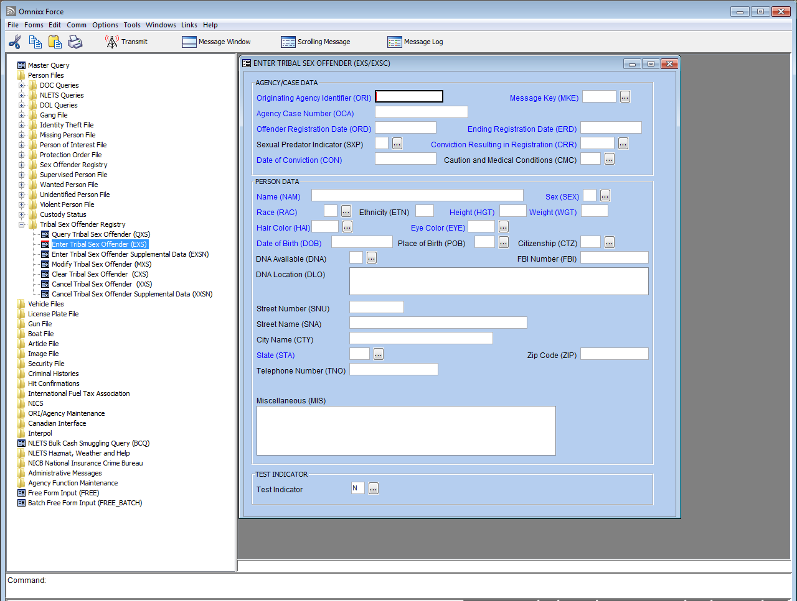
Omnixx NSOR Entry Screen
Mandatory Fields (blue)
Optional Fields (black)

Slide 4
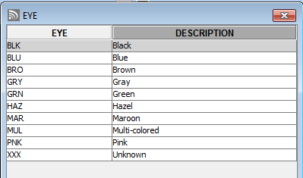
Omnixx NSOR Entry Screen
WADI05400
Agency's Primary ORI
NCIC Codes (click on ellipse)
Miscellaneous Field to include confirmation phone number

Slide 5
NCIC Acknowledgment Message from NSOR Entry
1L01043YPO479NEXSC
WAWSP0099
NAM/SMITH, BILLY JO NIC/X142099522
OCA/1401234
TRACKING
07/31/2014, 11:56:28 - MKE: EXSC - Source: NCIC - To: BILLM - ISN: 043YPO47A1 - REF: 043YPO479N

Slide 6
NCIC Return for NSOR
*** SEX OFFENDER REGISTRY INFORMATION ***
THE SUBJECT IDENTIFIED IN THE FOLLOWING RECORD WITH NIC/X142099522
IS REGISTERED AS A SEX OFFENDER. DO NOT SEARCH, DETAIN, OR
ARREST BASED SOLELY ON THIS RECORD. ADDITIONAL INFORMATION REGARDING
SUBJECT MAY BE AVAILABLE FROM THE INTERSTATE IDENTIFICATION INDEX.
MKE/SEXUAL OFFENDER
ORI/WADI00099 NAM/SMITH, BILLY JO SEX/M RAC/W POB/WA
DOB/19600101 HGT/510 WGT/180 EYE/BR0 HAI/BR0 CTZ/US
ORD/20140101 ERD/20990101 SXP/N CRR/LEWD OR LASCIVIOUS ACTS WITH MINOR
CON/20000101
OCA/1401234
MIS/THIS FIELD SH0ULD C0NTAIN ENTERING AGENCIES PH0NE NUMBER
MIS/AND ANY 0THER CAUTI0N 0R DESCRIPTIVE INF0RMATI0N
DNA/Y DLO/SEATTLE CRIME LAB
SNU/102 SNA/S 1ST AVE
CTY/ANYPLACE STA/WA ZIP/98501
TNO/360 534-0911
ORI IS A WASHINGTON STATE TRIBAL POLICE DEPARTMENT 360 705-5999
NIC/X142099522 DTE/20140731 1456 EDT DLU/20140731 1456 EDT
***** END OF SEX OFFENDER REGISTRY INFORMATION *****
TRACKING 07/31/2014, 11:58:56 - MKE: QXS - Source: NCIC - To: BILLM - ISN: 043YPO4943 - REF: 043YPO493X

Slide 7
Updating NSOR Entries
Modify
  Add information to a blank field
  Delete information from a field
  Change/correct information in a field
Supplement
  Up to 99 aka’s
  Up to 10 caution or medical conditions
  Up to 9 dates of birth, citizenships, telephone numbers, telephone number types
Clear – Person no longer needing to register or has registered with another jurisdiction
Cancel – Record is invalid, offense has been expunged or pardoned or by jurisdictional policy or procedures

Slide 8
Additional Information
Fingerprints and photographs are submitted directly to FBI using electronic fingerprint/palm print device.
Resource Sharing – can tribes work together to enter NSOR for other tribes without the resources?

Slide 9
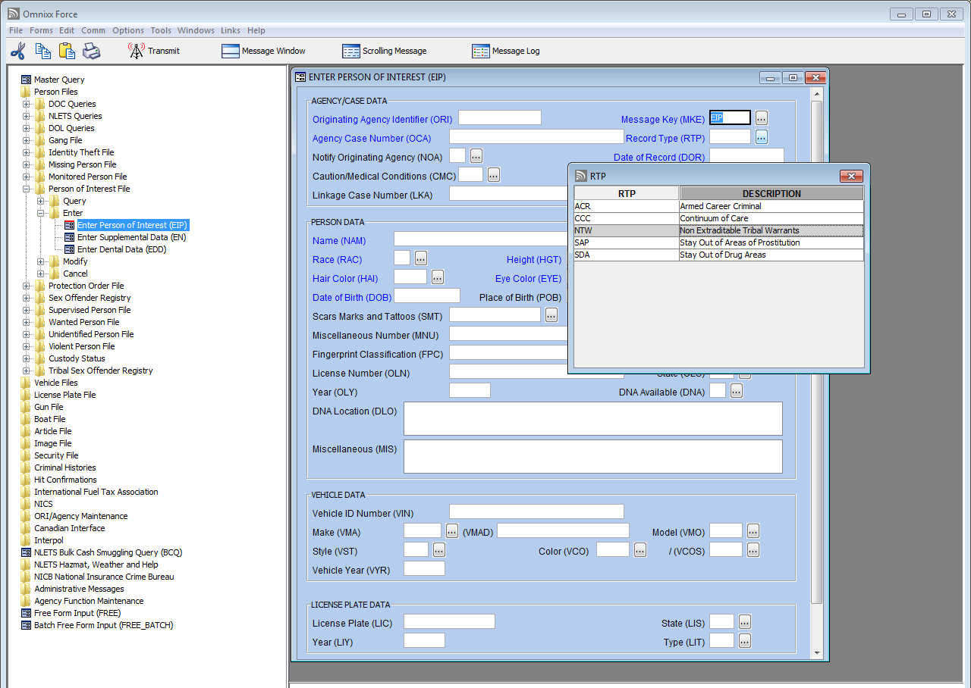
Person of Interest
Non-Extraditable Tribal Warrants
WADI05400
Tribal Warrant record type

Slide 10
Non-Extraditable Tribal
Warrant Return
------ RECORD NUMBER 1 OF 1 ------
EXACT MATCH
NON-EXTRADITABLE TRIBAL WARRANT (BASED ON NAM/DOB)
MKE/EIP ORI/WADI01400 NAM/SMITH, BILL.M.I.WA.09/13/1964
HGT/507 WGT/170 EYE/BRO HAR/BLK SKN/FAR
OCA/131234 SMT/TAT L ARM
OLN/TESTOLNNUM1555.WA.2015
LIC/ABC1234.WA.2015.PC
VIN/FAKEVIN12544454.2009.FORD.ESC.4D.43D
DOR/05/01/2013 RTP/NTW
MIS/CONFIRM 360-222-1212
DNA/Y DLO/SEATTLE CRIME LAB
ORI IS NOOKSACK PD DEMING 360-222-1212
ENT:05/02/2013 AT 0620 FROM NOOKSACK PD BY/WSP WACIC
WAC/13H0004492

Slide 11
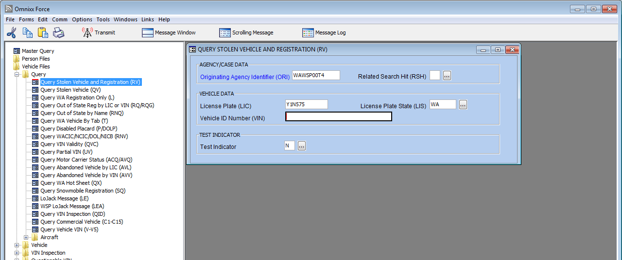
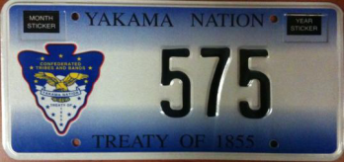
Yakama Nation License Plates
Must use a Y1N before the plate number to receive a return

Slide 12
Yakama Nation License Plates Return
************************************************************************
REGISTRATION RESPONSE
************************************************************************
RR.WALIC0000
16:27_09/08/2014_14857
16:27_09/08/2014_25564_WAWSP00T4
*045100Q9DJ
TXT
*** REGISTRATION DETAILS ***
VEHICLE REGISTRATION EFFECTIVE DATE: 2013-04-23
VEHICLE REGISTRATION EXPIRATION DATE: 2015-04-30
REGISTERED TO: BILL SMITH
ADDRESS: MAILING ADDRESS: 123 BUSY LN; WAPATO,WA 98951
VEHICLE REGISTRATION PLATE ID: 575
VEHICLE REGISTRATION PLATE TYPE: PC
PERMANENT REGISTRATION INDICATOR: false
VEHICLE DECAL: 5272
*** VEHICLE DETAILS ***
VEHICLE ID: 1G2CD34B5N6789123
VEHICLE MODEL YEAR: 2000
VEHICLE MODEL TEXT: DEVILLE
VEHICLE PRIMARY COLOR: BLACK
VEHICLE BRAND: CADI
VEHICLE CMV INDICATOR: false

Slide 13
Thank You!
Bill McAllister
William.mcallister@wsp.wa.gov
(360) 534-2181

